Slide 1
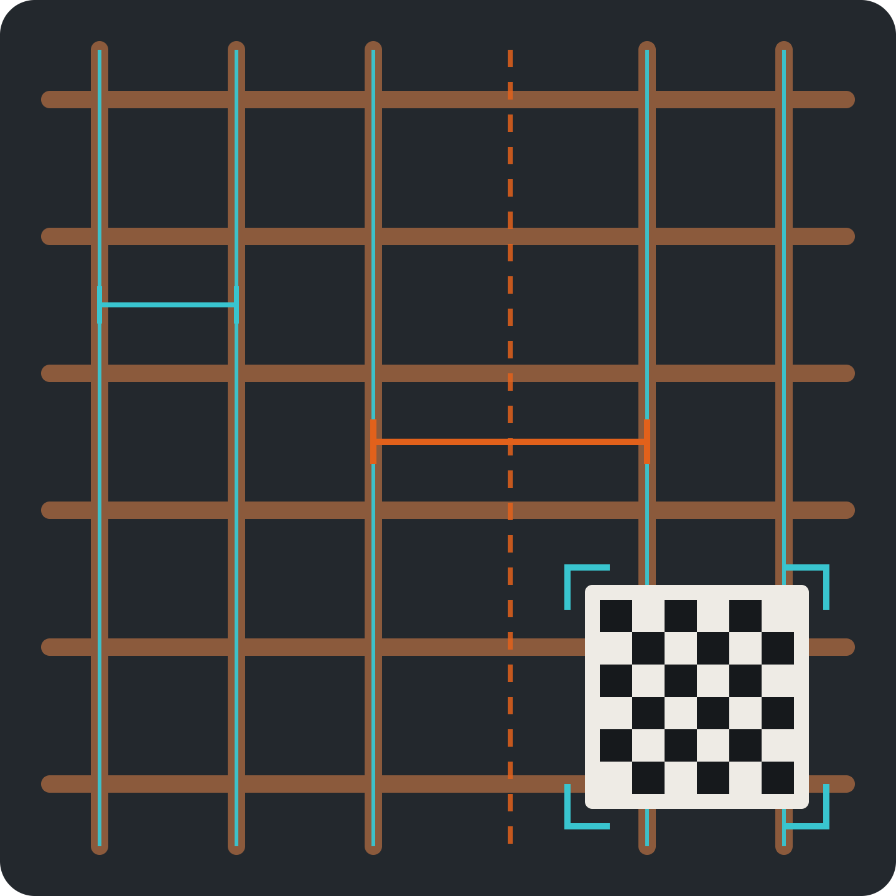
SARIYA
IQOO HACKATHON 2026 · GRAND FINALE
150 ± 5 mm
सरिया · what India's building sites call rebar
300 ± 6 mm · drawing 150
Check the steel before
the concrete hides it.
One iQOO phone and a printed card measure the steel live on the Snapdragon NPU, speak the fix in Hindi or Kannada, and sign a record for the engineer. Fully offline.
Open Innovation
On-device NPU
Office Kit
Hindi · Kannada
Team Sarpatta · Melvin, Lead Engineer · Alwin, UI/UX · Sabari, AI Engineer
Notes:
One sentence: a phone checks a house's steel the evening before the concrete covers it. Everything on this slide is the product: the cyan traces are what the NPU model finds, the orange gap is a missing bar measured against the drawing, the card gives true scale.

Slide 2
Sariya in 30 seconds
AT A GLANCE
PROBLEM
Steel hidden within days
Concrete covers it for good. Today it is checked by eye, with no record.
NOVELTY
Japan has it. India doesn't.
Camera rebar checks accepted in Japan since 2023. No phone tool for India's pour.
TECH IMPACT
Live measurement on the NPU
An open segmentation model finds every bar; plain-code rules keep verdicts auditable.
PHONE-FIRST
The camera is the instrument
Torch, gyro, mic, speaker, keystore and Office Kit all carry load. Fully offline.
SCOPE FIT
Four items, loop by hour 30
A fallback for every risky part. Everything else is roadmap.
Sariya · Team Sarpatta · Open Innovation track
02
Notes:
This is the screener's slide: one line per screening factor. Each later slide expands one row.

Slide 3
Steel is visible for a day or two, then hidden for good
PROBLEM CHOICE
DAY 1–2
EVENING BEFORE
POUR DAY
AFTER
Steel tied
Last chance to check
Pour
Hidden for 50+ years
↑ SARIYA SCANS HERE
What vanishes under the concrete
55–57%
Uniform stirrups that skip the tight spacing at beam ends
Missing, substituted or wider-spaced bars
Top steel trampled flat over supports
No cover blocks under the mesh
of India's cement demand is housing (CRISIL, FY25)
Risk is moving to the engineer. Bengaluru lets registered professionals self-certify plans, and small Karnataka homes no longer need an occupancy certificate.
Sources: CRISIL Industry Report (Jul 2025) · BBMP Nambike Nakshe · Karnataka OC exemption (2025–26)
03
Notes:
Keep this about the moment, not about collapses. We never link any named collapse to its steel. The point: the check window is one evening, and nothing measures or records it.

Slide 4




The site engineer, the evening before the pour
ONE USER, ONE MOMENT
Who holds the phone
Today
With Sariya
Whoever is already paid to check the steel: the owner's engineer, a builder's QC lead, or a brand's technical engineer.
A walk-round by eye, a tape on a few bars, a phone photo. No numbers against the drawing. No record.
Measured values with error bands, checked against the drawing. The fix spoken to the mason. A signed, dated record.
The mason never holds the phone. They hear the fix in their language, and the record shows what they corrected.
Brands already send engineers to slab casting (JSW Cement, UltraTech), unmeasured and unrecorded
04
Notes:
Why not the mason: a flagged fault would incriminate him and cost him a gang-day. The operator is whoever is already paid to check. After the event, the first users are brand technical engineers.

Slide 5
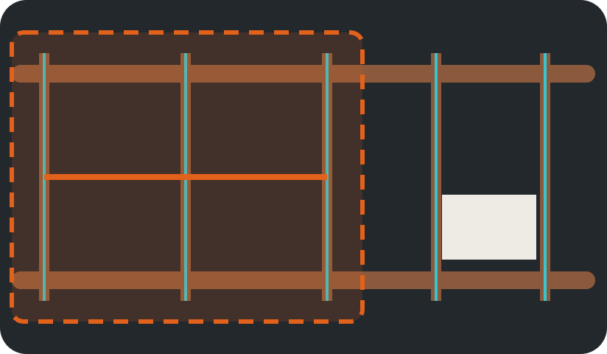
Speak. Scan. Fix. Sign.
THE PRODUCT LOOP
offline · NPU live
1
Speak the drawing
"Beam B2: four 12s, stirrups 8 at 100 near the ends." Gemma fills five typed fields; the engineer confirms each.
2
Lay the card, scan
BEAM B2 · LEFT END
The printed card gives true scale. A live overlay shows which bars are measured and where to move next.
180 ± 7 mm
3
Read the verdict
Drawing: 100 mm for the first 600 mm
Count, spacing and stirrup zones against the drawing and IS 456, each with ± error. Too close to call: "re-scan".
Outside limits · add 4
4
Fix, then sign
"बीम B2, बाएँ सिरे पर रिंग 180 पर हैं, ड्रॉइंग में 100। चार रिंग और डालिए।"
The fix is spoken in Hindi or Kannada with subtitles. Signed on the phone, countersigned over Office Kit.
No drawing? Measurement-only mode: values, no verdict
05
Notes:
Five spec fields per member: bar diameter, bar count or spacing, stirrup diameter, stirrup spacing at end zone and mid-span, end-zone length. The language model only transcribes and words; it never decides a number. Mock-up only: no code exists before the event, by rule.

Slide 6
It measures what it sees, and says when it can't
HONEST BY DESIGN
Four verdicts. Never "safe".
What a camera can't see, it asks for
Within limits
Outside limits
COVER
Needs a tape reading
Not seen
A tape reading, spoken and recorded
BAR DIAMETER
THE RE-SCAN RULE
Weigh a 1 m offcut: 10 mm = 0.617 kg, 12 mm = 0.888 kg (IS 1786). Catches underweight steel too.
If a value sits within its own error band of the limit, the phone says "re-scan" instead of guessing.
HOOKS
RESOLUTION
A close-up against a 135° template card, only where the drawing asks
About 0.19 mm per pixel at 50 cm and 0.38 mm at 1 m (main camera, 4K). Every number carries its ± band.
Japan's MLIT guideline notes bars one size apart can't always be told apart by camera. We use the scale.
06
Notes:
This is the slide that earns trust with a technical jury. The rulebook is versioned: the drawing first, IS 456 everywhere, IS 13920 required in zones III to V and advisory in zone II (Bengaluru). Sariya measures and records; the engineer certifies.

Slide 7
Every chip on the phone has a job
TECH IMPACT · ON-DEVICE AI
Camera + torch
→
NPU mask
→
Centrelines
→
Card → mm
→
Rulebook
→
Voice + signed record
HEXAGON NPU
ADRENO GPU
CPU
PLAIN CODE
Live rebar masks
Gemma 4 E2B
Voice and scale
Auditable verdicts
Open weights via LiteRT, fine-tuned at the event. Published for this chip: about 2 ms a frame; 17 ms end to end vs 73 ms on CPU.
Turns the spoken drawing into five typed fields, each confirmed, and words the fix. It never decides a number.
IndicConformer for offline Hindi and Kannada speech. OpenCV ChArUco maps pixels to millimetres.
Error carried from pixel to mm, a versioned IS-code rulebook, records signed in the hardware keystore.
LiteRT · INT8 weights
LiteRT-LM · Apache-2.0
sherpa-onnx · MIT
Versioned rules
Timings: Qualcomm AI Hub, Ultralytics docs; we re-measure them on the loaner in hour 1. Nothing goes to the cloud.
07
Notes:
Gemma 4 E2B has no NPU build for this chip, so it runs on the GPU; segmentation owns the NPU. Quantisation: int8 weights with int16 activations, compared against float for thin-bar mask quality. Model choice in hour 1: YOLO-seg (measured on this chip, AGPL, fine for a public repo) or DeepLabV3+-MobileNet (permissive). All models open and attributed: Gemma 4 E2B (Apache-2.0), IndicConformer (MIT), OpenCV.

Slide 8





On a roof slab at dusk, only a phone can do this job
PHONE-FIRST FIT
OFFICE KIT, BOTH WAYS
CAMERA
TORCH
GYRO
The measuring instrument
Even light on dull steel
Picks the sharpest frames
Laptop → phone
Bar schedule and drawing numbers
Phone → laptop
Signed scans to review, a re-scan request, the countersign
MIC
SPEAKER
KEYSTORE
Drawing numbers and tape readings
Speaks the fix to the mason
Hardware-backed signing
Offline by need: sites are often out of signal, and faces and home locations never leave the phone.
Phone-only hours at the event: we scan our props again and again to grow the error table
08
Notes:
Every sensor named here is used in the four build items, not decoration. No cloud cost per scan.

Slide 9
Japan proved it. India's self-built pour has no tool.
NOVELTY
Who | Measures steel | Before pour | Phone, offline | Built for India
Japan: AIJO, IHI, Kentem | Yes | Yes | Tablet or rig | No
Indian site-QC apps | Photos only | Yes | Yes | Yes
Brand site engineers | By eye | Yes | Human visit | Yes
Cover meters (Profometer) | Yes | After pour | Extra hardware | Partly
Sariya | Yes, ± band | Yes | Yes | Yes
WHAT IS NEW
Japan's MLIT has accepted camera rebar measurement at the pre-pour check since July 2023 (±5 mm guide on spacing). We bring it to one phone, offline, with IS-code rules, Hindi and Kannada, and a "re-scan" when unsure.
Source: MLIT implementation guideline (draft), Jul 2023 · Our search found no Indian phone tool for placed steel
09
Notes:
Say Japan first, before a judge does. It proves the category and the physics. Examples: Japan also has Kajima's stereo system; Indian site-QC apps include Brick&Bolt and Powerplay; brand engineers from JSW Cement and UltraTech; cover meters include Profometer and Nirixense ReX. Our search for Indian competitors was English web search, not app-store or Hindi/Kannada queries.

Slide 10
Full loop working by hour 30. Hours 30–48 harden it.
SCOPE FIT · ALL CODE AT THE EVENT · WE SHIPPED ON THIS IQOO 15 AT CHENNAI
BUILD
0h
12
24
30
48h
IF IT BREAKS
Probe the loaner: NPU, camera, voices
GPU delegate
1 · Bar count and spacing on a slab mesh
Line detection, tap to mark
2 · Beam stirrup zones + rulebook
Zone ends marked on the strip
3 · Voice in, fix out
4 · Signed record over Office Kit
Form entry; Hindi with subtitles
Harden: tune on props, error table, rehearse, stretch goals
Cut stretch goals first
Not built at the event: card-free depth, rib-mark brand reading, drawing extraction, integrations
10
Notes:
Screeners scored scope as the weak spot in reviews, so this slide answers it head-on: four numbered items, a fallback for each, and a hard line on what is not built. Scope is bounded by the card: planar faces, one homography, no 3-D reconstruction. The model starts from public pretrained weights, attributed, and is fine-tuned at the event. Stretch goals: diameter close-up, hook template, NPU/GPU/CPU numbers screen.

Slide 11
A judge breaks the steel. The phone finds it.
THE DEMO · 3 MINUTES · AIRPLANE MODE
0:00
0:30
1:10
1:40
2:10
A judge draws a fault card and breaks our mesh: a bar removed, moved or opened.
Scan at 50 cm. The verdict lands in seconds, spoken in Hindi with subtitles.
The judge tapes the exact segment the app drew and checks the number.
From 1.2 m the phone says "re-scan, within my error". It refuses to guess.
The engineer countersigns over Office Kit. A replayed scan is rejected.
WE BRING
A 45 × 45 cm mesh of 8 mm bars in slotted clips, a 60 cm beam cage, printed cards, a tape, an LED panel and a spare phone.
Nothing is pre-recorded: the judge places the fault and checks the answer with a tape
11
Notes:
The demo survives a noisy hall: nothing depends on audio, subtitles always on. Failure branch: if segmentation struggles under stage light, tap-to-mark fallback still runs the card metrology and rulebook.

Slide 12
People already pay for site checks. None measure steel.
MARKET AND BUSINESS MODEL
55–57%
31,698
₹4,999
₹750–2,000
of India's cement demand is housing (CRISIL, FY25)
sites where one cement brand supervised slab casting in a year (Ambuja)
per construction-stage visit by a Bengaluru home inspector (TeamHome)
per lender technical visit, which checks progress, not steel (Aptus)
ENGINEERS, INSPECTORS
BUILDERS
CEMENT, STEEL BRANDS
LENDERS
₹199 / signed pour
₹2,999 / house
Licence per engineer
Per tranche
Scanning is free. Pay per signed record.
Every pour of one build, in one log
Branded reports, slab-date leads
A measured record beside each visit
Prices are hypotheses, not yet tested with buyers. On-device means no per-scan cloud cost.
12
Notes:
Every figure on the top row was opened at its source: CRISIL industry report in JSW Cement's offer document (FY25); Ambuja Cement annual report, slab supervision at 31,698 customer sites; TeamHome TH-Shield, Rs 4,999 per visit; Aptus HFC fee schedule, Rs 1,500 to 2,000 plus GST for the first technical visit and Rs 750 plus GST after. Brands are the first target: their engineers already stand at the pour, and Sariya lets each one cover more sites with a signed, measured report. Pricing is a hypothesis.

Slide 13
From one phone at the Finale to every pour
ROADMAP AND THE ASK
BEFORE 9 OCT
FINALE · 9–11 OCT
AFTER
Data, not code
The full loop, one phone
Pilots with brand engineers
Tape Bengaluru pre-pour sites for a test set, have a structural engineer review the rulebook, build the demo props.
Count, spacing and stirrup zones; the fix in Hindi and Kannada; a signed record over Office Kit.
Then builders, inspectors and lender tranche records. Later: card-free depth and rib-mark brand checks.
The iQOO 15 already sees every bar.
Let it check them before the concrete does.
No partner is named without consent; brand pilots are the first target, not yet agreed
13
Notes:
Before the Finale the work is data and people, not code: site visits with a tape, one structural engineer on record, the props. At the Finale, the four build items. After, brand technical engineers first, because they already stand at the pour. The closing line is the ask to iQOO: the phone's camera is already a measuring instrument.

Slide 14
Every pour leaves a measured, signed record.
IMPACT
HOMEOWNER
ENGINEER
MASON
Proof of what is inside the slab, dated and signed
Measured evidence behind every sign-off they give
The fix in their language, and a record that it was made
TEAM SARPATTA · 3+ YEARS, 3+ TINKERHUB WINS · SHIPPED ON THIS IQOO 15 AT CHENNAI
Melvin
Alwin
Sabari
Lead Engineer
UI/UX
AI Engineer
Sariya measures and records. The engineer certifies. It never says "safe".
14
Notes:
Close on the guardrail line. If you have site data by the time you submit (N Bengaluru pre-pour sites taped), add it as one line; it is the strongest single proof point.

